Slide 1
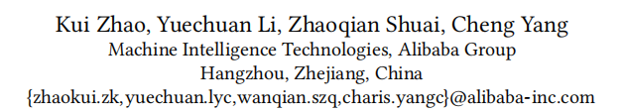
Learning and Transferring IDs Representation in E-commerce

Slide 2
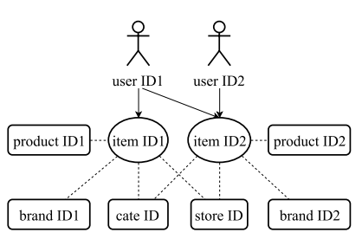
Item ID and its attribute IDs
item ID,product ID, store ID, brand ID, cate-level1 ID, cate-level2 ID and
cate-level3 ID
User ID

Slide 3
Contributions
Measuring the similarity between items
Transferring from seen items to unseen items
Transferring across different domains
Transferring across different tasks

Slide 4
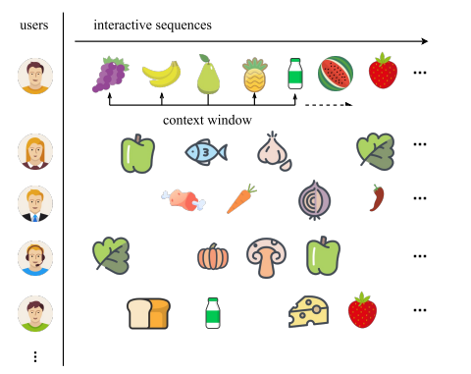
Skip-gram on User’s Interactive Sequences

Slide 5

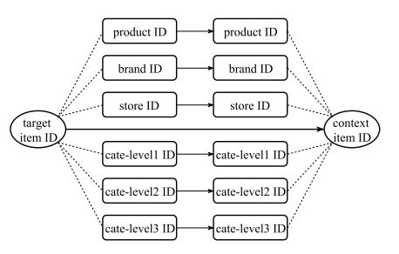
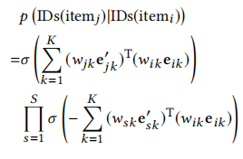

Jointly Embedding Attribute IDs

Slide 6


Measuring Items Similarity
measuring item similarities by cosine distances among embedding vectors
Transferring from Seen Items to Unseen Items

Slide 7
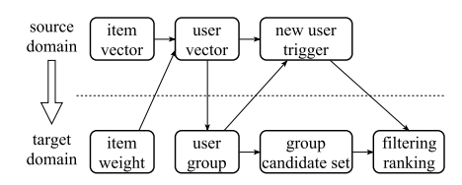
Transferring across Different Domains
user vectors forUs are calculated in Taobao
users in Ui are clustered into 1000 groups
the new coming user in Us\Ut is assigned to the most similar group

Slide 8
